Slide 1
Parameter Estimation and Control of Multirotors Using Integral Concurrent Learning
Cheng-Cheng Yang and Teng-Hu Cheng
Speaker : Cheng-Cheng Yang
Advisor : Dr. Teng-Hu Cheng
Date : 2021/08/02

Slide 2
Outlines
Motivation
Problem Formulation
Controller Design
Stability Analysis
Experiments
Conclusion

Slide 3
Motivation
Knowledge of the geometric and inertia parameters is essential to achieving good control performance.
The payload or sensors attaching to multirotors may change the geometric and inertia parameters.
Some geometric and inertia parameters like moment of inertia can not be measured through instrument.
Existing adaptive control method can only guarantee the stability of multirotors system, can not ensure the parameters converge.

Slide 4
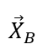
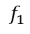
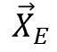
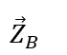
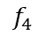
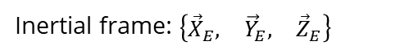
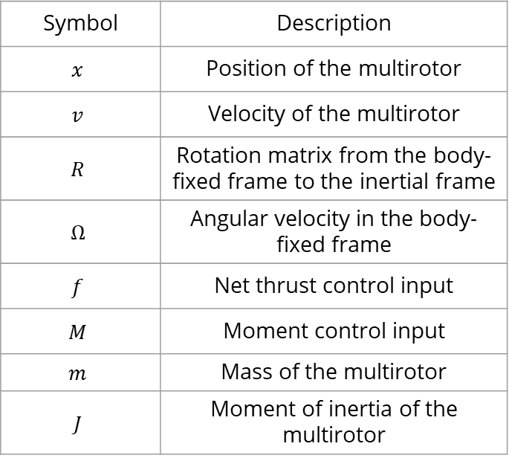
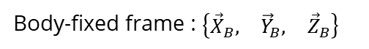
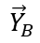
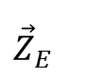
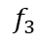
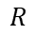
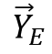
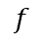
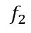
Problem Formulation - Definition of Symbols
Symbol | Description
$$x$$ | Position of the multirotor
$$v$$ | Velocity of the multirotor
$$R$$ | Rotation matrix from the body-fixed frame to the inertial frame
$$Ω$$ | Angular velocity in the body-fixed frame
$$f$$ | Net thrust control input
$$M$$ | Moment control input
$$m$$ | Mass of the multirotor
$$J$$ | Moment of inertia of the multirotor
$$f_{4}$$
$$f_{1}$$
$$f$$
$$f_{3}$$
$${\vec{X}}_{B}$$
$${\vec{Y}}_{B}$$
$$f_{2}$$
$$R$$
$$x$$
$${\vec{Z}}_{B}$$
$${\vec{X}}_{E}$$
$${\vec{Y}}_{E}$$
$${\vec{Z}}_{E}$$
Body-fixed frame : $\left\{\begin{matrix}{\vec{X}}_{B}, & {\vec{Y}}_{B}, & {\vec{Z}}_{B}\end{matrix}\right\}$
Inertial frame: $\left\{\begin{matrix}{\vec{X}}_{E}, & {\vec{Y}}_{E}, & {\vec{Z}}_{E}\end{matrix}\right\}$

Slide 5
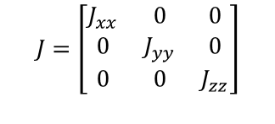

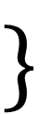
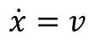
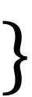
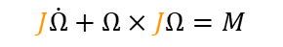
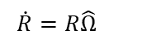
Problem Formulation - Dynamics of the Multirotor
The multirotor is described by both translational and rotational dynamics.
The translational dynamics considers forces such as the effects of gravity, thrusts, and the external force.
The rotational dynamics takes the moment control input, rotational speed, and moment of inertia into account.
$$\}$$
$$\dot{x}=v$$
Translational dynamics
$$J=\left[\begin{matrix}J_{xx} & 0 & 0 \\ 0 & J_{yy} & 0 \\ 0 & 0 & J_{zz}\end{matrix}\right]$$
$$m\dot{v}=mge_{3}−fRe_{3}$$
$$\}$$
$$\dot{R}=R\hat{Ω}$$
Rotational dynamics
$$J\dot{Ω}+Ω×JΩ=M$$

Slide 6
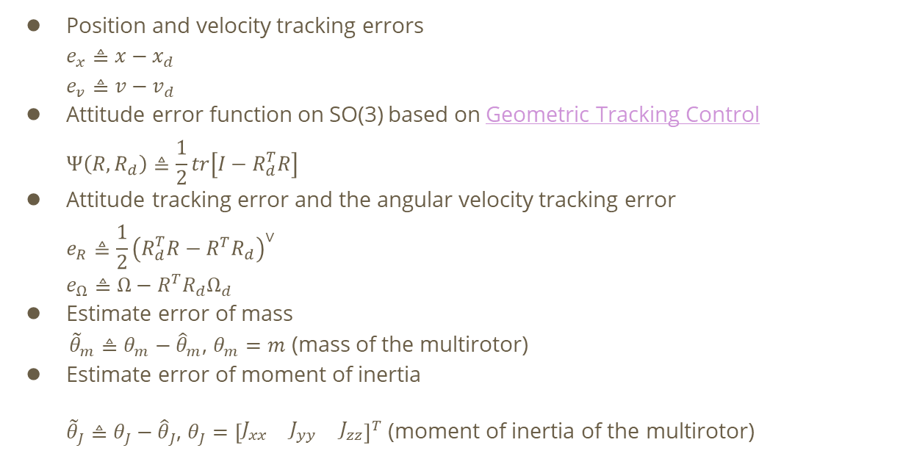
Problem Formulation – Tracking Errors and Estimate Errors
Position and velocity tracking errors
$$e_{x}≜x−x_{d}$$
$$e_{v}≜v−v_{d}$$
Attitude error function on SO(3) based on Geometric Tracking Control
$$Ψ\left(R, R_{d}\right)≜\frac{1}{2}tr\left[I−R_{d}^{T}R\right]$$
Attitude tracking error and the angular velocity tracking error
$$e_{R}≜\frac{1}{2}{\left(R_{d}^{T}R−R^{T}R_{d}\right)}^{∨}$$
$$e_{Ω}≜Ω−R^{T}R_{d}Ω_{d}$$
Estimate error of mass
${\tilde{θ}}_{m}≜θ_{m}−{\hat{θ}}_{m}$, $θ_{m}=m$ (mass of the multirotor)
Estimate error of moment of inertia
${\tilde{θ}}_{J}≜θ_{J}−{\hat{θ}}_{J}$, $θ_{J}={\left[\begin{matrix}J_{xx} & J_{yy} & J_{zz}\end{matrix}\right]}^{T}$ (moment of inertia of the multirotor)

Slide 7
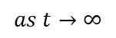
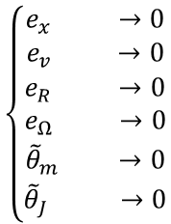
Problem Formulation – Control Objectives
Track a desired 3D trajectory
Track a desired yaw angle
Estimate the mass of the multirotor
Estimate the moment of inertia of the multirotor
$$\left\{\begin{aligned}\begin{matrix}e_{x} & →0\end{matrix} \\ \begin{matrix}e_{v} & →0\end{matrix} \\ \begin{matrix}\begin{matrix}e_{R} & →0\end{matrix} \\ \begin{matrix}e_{Ω} & →0\end{matrix} \\ \begin{matrix}\begin{matrix}{\tilde{θ}}_{m} & →0\end{matrix} \\ \begin{matrix}{\tilde{θ}}_{J} & →0\end{matrix}\end{matrix}\end{matrix}\end{aligned}\right.$$
$$as t→∞$$
3D position
3D trajectory
yaw angle
desired yaw angle

Slide 8
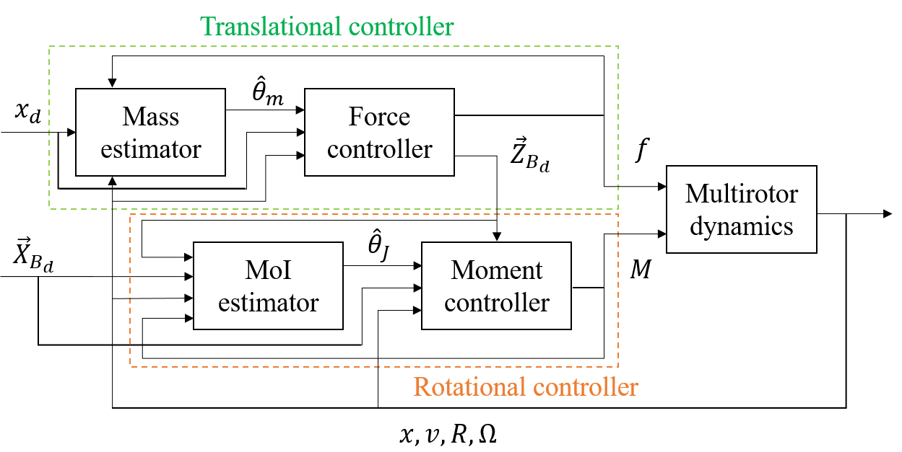
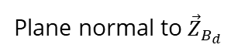
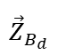
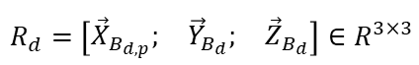
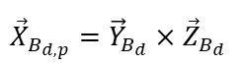
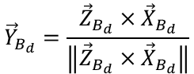
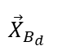
Controller Design – Control Architecture
$${\vec{X}}_{B_{d}}$$
Plane normal to ${\vec{Z}}_{B_{d}}$
$${\vec{X}}_{B_{d,p}}={\vec{Y}}_{B_{d}}×{\vec{Z}}_{B_{d}}$$
$${\vec{Y}}_{B_{d}}=\frac{{\vec{Z}}_{B_{d}}×{\vec{X}}_{B_{d}}}{\left\|{\vec{Z}}_{B_{d}}×{\vec{X}}_{B_{d}}\right\|}$$
$${\vec{Z}}_{B_{d}}$$
$$R_{d}=\left[\begin{matrix}{\vec{X}}_{B_{d,p}}; & {\vec{Y}}_{B_{d}}; & {\vec{Z}}_{B_{d}}\end{matrix}\right]∈R^{3×3}$$

Slide 9

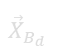
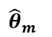
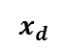
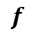

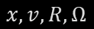
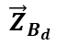
Controller Design – Translational Controller
Translational controller
Translational controller
$$x_{d}$$
Mass
estimator
$${\hat{θ}}_{m}$$
Force
controller
$${\vec{Z}}_{B_{d}}$$
$$f$$
Multirotor
dynamics
$${\vec{X}}_{B_{d}}$$
$${\hat{θ}}_{J}$$
MoI
estimator
Moment
controller
$$M$$
Rotational controller
$$x, v, R, Ω$$

Slide 10
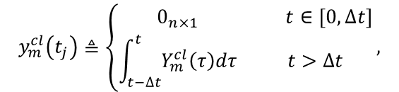
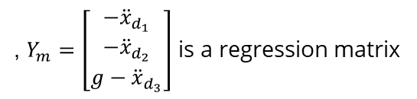
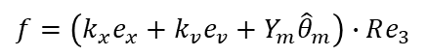
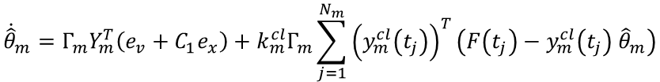
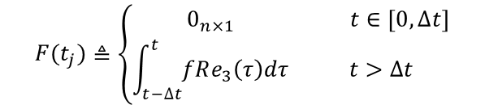
Controller Design – Translational Controller
Translational controller
, $Y_{m}=\left[\begin{matrix}−{\ddot{x}}_{d_{1}} \\ −{\ddot{x}}_{d_{2}} \\ g−{\ddot{x}}_{d_{3}}\end{matrix}\right]$ is a regression matrix
$$f=\left(k_{x}e_{x}+k_{v}e_{v}+Y_{m}{\hat{θ}}_{m}\right)∙Re_{3}$$
$$=feedback term+adaptive term$$
Integral CL-based adaptive control update law ${\dot{\hat{θ}}}_{m}$
$${\dot{\hat{θ}}}_{m}=Γ_{m}Y_{m}^{T}\left(e_{v}+C_{1}e_{x}\right)+k_{m}^{cl}Γ_{m}\sum_{j=1}^{N_{m}}{{\left(y_{m}^{cl}\left(t_{j}\right)\right)}^{T}\left(F\left(t_{j}\right)−y_{m}^{cl}\left(t_{j}\right) {\hat{θ}}_{m}\right)}$$
$$=adaptive term+ICL−based term$$
$$y_{m}^{cl}\left(t_{j}\right)≜\left\{\begin{matrix}0_{n×1} & t∈\left[0,∆t\right] \\ \int_{t−∆t}^{t}{Y_{m}^{cl}\left(τ\right)dτ} & t>∆t\end{matrix}\right.,$$
$$F(t_{j})≜\left\{\begin{matrix}0_{n×1} & t∈\left[0,∆t\right] \\ \int_{t−∆t}^{t}{fRe_{3}\left(τ\right)dτ} & t>∆t\end{matrix}\right.$$

Slide 11
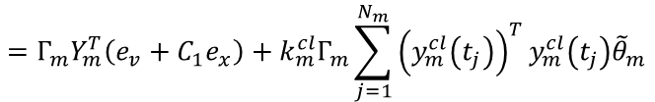
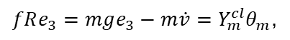
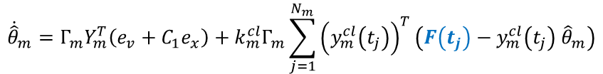
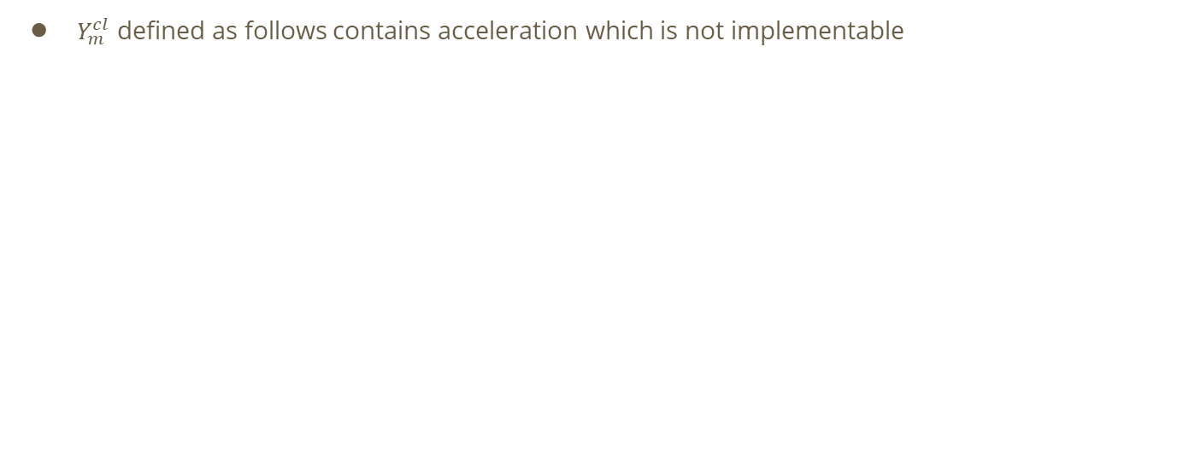
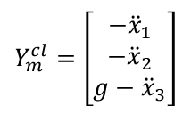
Controller Design – Translational Controller
$Y_{m}^{cl}$ defined as follows contains acceleration which is not implementable
$$Y_{m}^{cl}=\left[\begin{matrix}−{\ddot{x}}_{1} \\ −{\ddot{x}}_{2} \\ g−{\ddot{x}}_{3}\end{matrix}\right]$$
$$fRe_{3}=mge_{3}−m\dot{v}=Y_{m}^{cl}θ_{m}\text{,}$$
By integrating $Y_{m}^{cl}$ to be $y_{m}^{cl}$ as defined in last page, $y_{m}^{cl}$ becomes implementable
Integrating both sides of the translational dynamics $fRe_{3}=Y_{m}^{cl}θ_{m}$ yields
$$\int_{t−∆t}^{t}{fRe_{3}}\left(τ\right)dτ=\int_{t−Δt}^{t}{Y_{m}^{cl}\left(τ\right)θ_{m}dτ}⇒\int{fRe_{3}\left(τ\right)}{\left.​\right|}_{τ=t}−\int{fRe_{3}\left(τ\right)}{\left.​\right|}_{τ=t−Δt}=y_{m}^{cl}θ_{m}$$
$${\dot{\hat{θ}}}_{m}=Γ_{m}Y_{m}^{T}\left(e_{v}+C_{1}e_{x}\right)+k_{m}^{cl}Γ_{m}\sum_{j=1}^{N_{m}}{{\left(y_{m}^{cl}\left(t_{j}\right)\right)}^{T}\left(F\left(t_{j}\right)−y_{m}^{cl}\left(t_{j}\right) {\hat{θ}}_{m}\right)}$$
$$=Γ_{m}Y_{m}^{T}\left(e_{v}+C_{1}e_{x}\right)+k_{m}^{cl}Γ_{m}\sum_{j=1}^{N_{m}}{{\left(y_{m}^{cl}\left(t_{j}\right)\right)}^{T}y_{m}^{cl}\left(t_{j}\right){\tilde{θ}}_{m}}$$

Slide 12
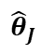
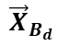
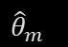




Controller Design – Rotational Controller
Rotational controller
Translational controller
$$x_{d}$$
Mass
estimator
$${\hat{θ}}_{m}$$
Force
controller
$${\vec{Z}}_{B_{d}}$$
$$f$$
Multirotor
dynamics
$${\vec{X}}_{B_{d}}$$
$${\hat{θ}}_{J}$$
MoI
estimator
Moment
controller
$$M$$
Rotational controller
$$x, v, R, Ω$$

Slide 13





Controller Design – Rotational Controller
Rotational controller
, $Y_{J}=\left[\begin{matrix}{\overline{Ω}}_{1} & Ω_{2}∙Ω_{3} & −Ω_{2}∙Ω_{3} \\ −Ω_{1}∙Ω_{3} & {\overline{Ω}}_{2} & Ω_{1}∙Ω_{3} \\ Ω_{1}∙Ω_{2} & −Ω_{1}∙Ω_{2} & {\overline{Ω}}_{3}\end{matrix}\right]$
$$M=−k_{R}e_{R}−k_{Ω}e_{Ω}−Y_{J}{\hat{θ}}_{J}$$
$$=feedback term+adaptive term$$
Integral CL-based adaptive control update law ${\dot{\hat{θ}}}_{J}$
$${\dot{\hat{θ}}}_{J}=Γ_{J}Y_{J}^{T}\left(e_{Ω}+C_{2}e_{R}\right)+k_{J}^{cl}Γ_{J}\sum_{j=1}^{N_{J}}{{\left(y_{J}^{cl}\left(t_{j}\right)\right)}^{T}\left(\overline{M}\left(t_{j}\right)−y_{J}^{cl}\left(t_{j}\right) {\hat{θ}}_{J}\right)}$$
$$=adaptive term+ICL−based term$$
$$y_{J}^{cl}\left(t_{j}\right)≜\left\{\begin{matrix}0_{n×m} & t∈\left[0,∆t\right] \\ \int_{t−∆t}^{t}{Y_{J}^{cl}\left(τ\right)dτ} & t>∆t\end{matrix}\right.,$$
$$\overline{M}(t_{j})≜\left\{\begin{matrix}0_{n×m} & t∈\left[0,∆t\right] \\ \int_{t−∆t}^{t}{M\left(τ\right)dτ} & t>∆t\end{matrix}\right.$$

Slide 14






Controller Design – Rotational Controller
$Y_{J}^{cl}$ defined as follows contains angular acceleration which is not implementable
$$Y_{J}^{cl}=\left[\begin{matrix}{\dot{Ω}}_{1} & −Ω_{2}∙Ω_{3} & Ω_{2}∙Ω_{3} \\ Ω_{1}∙Ω_{3} & {\dot{Ω}}_{2} & −Ω_{1}∙Ω_{3} \\ −Ω_{1}∙Ω_{2} & Ω_{1}∙Ω_{2} & {\dot{Ω}}_{3}\end{matrix}\right]$$
$$M=J\dot{Ω}+Ω×JΩ=Y_{J}^{cl}θ_{J}\text{,}$$
By integrating $Y_{J}^{cl}$ to be $y_{J}^{cl}$ as defined in last page, $y_{J}^{cl}$ becomes implementable
Integrating both sides of the translational dynamics $M=Y_{J}^{cl}θ_{J}$ yields
$$\int_{t−∆t}^{t}{M}\left(τ\right)dτ=\int_{t−Δt}^{t}{Y_{J}^{cl}\left(τ\right)θ_{J}dτ}⇒\int{M\left(τ\right)}{\left.​\right|}_{τ=t}−\int{M\left(τ\right)}{\left.​\right|}_{τ=t−Δt}=y_{J}^{cl}θ_{J}$$
$${\dot{\hat{θ}}}_{J}=Γ_{J}Y_{J}^{T}\left(e_{Ω}+C_{2}e_{R}\right)+k_{J}^{cl}Γ_{J}\sum_{j=1}^{N_{J}}{{\left(y_{J}^{cl}\left(t_{j}\right)\right)}^{T}\left(\overline{M}\left(t_{j}\right)−y_{J}^{cl}\left(t_{j}\right) {\hat{θ}}_{J}\right)}$$
$$=Γ_{J}Y_{J}^{T}\left(e_{Ω}+C_{2}e_{R}\right)+k_{J}^{cl}Γ_{J}\sum_{j=1}^{N_{J}}{{\left(y_{J}^{cl}\left(t_{j}\right)\right)}^{T}y_{J}^{cl}\left(t_{j}\right){\tilde{θ}}_{J}}$$

Slide 15








Stability Analysis – Closed-Loop Error Systems
Taking the time derivative of error dynamics $e_{x}$, $e_{v}$ defined in Problem Formulation
$${\dot{e}}_{x}={\dot{e}}_{v}$$
$$m{\dot{e}}_{v}=mge_{3}−fRe_{3}−m{\ddot{x}}_{d}$$
$$=Y_{m}θ_{m}−fRe_{3}$$
$$=−k_{x}e_{x}−k_{v}e_{v}+Y_{m}{\tilde{θ}}_{m}−X$$
, $X=\frac{f}{e_{3}^{T}R_{d}^{T}Re_{3}}\left(\left(e_{3}^{T}R_{d}^{T}Re_{3}\right)Re_{3}−R_{d}e_{3}\right)$
Taking the time derivative of error dynamics $e_{R}$, $e_{Ω}$ defined in Problem Formulation
$${\dot{e}}_{R}=\frac{1}{2}{\left(R_{d}^{T}R{\hat{e}}_{Ω}+{\hat{e}}_{Ω}R^{T}R_{d}\right)}^{∨}$$
$$=\frac{1}{2}\left(tr\left[R^{T}R_{d}\right]I−R^{T}R_{d}\right)≡C\left(R_{d}^{T}R\right)e_{Ω}$$
$${J\dot{e}}_{Ω}=J\dot{Ω}+J\left(\hat{Ω}R^{T}R_{d}Ω_{d}−R^{T}R_{d}{\dot{Ω}}_{d}\right)$$
$$=J\dot{Ω}+J\overline{Ω}=M+Y_{J}θ_{J}=−k_{R}e_{R}−k_{Ω}e_{Ω}+Y_{J}{\tilde{θ}}_{J}$$

Slide 16






Stability Analysis – Translational Dynamics
Let Lyapunov function $V_{1}$ defined as
$$V_{1}=\frac{1}{2}k_{x}e_{x}^{T}e_{x}+\frac{1}{2}me_{v}^{T}e_{v}+C_{1}me_{x}∙e_{v}+\frac{1}{2}{\tilde{θ}}_{m}^{T}Γ_{m}^{−1}{\tilde{θ}}_{m}$$
$V_{1}$ is P.D. and it can be lower and upper bounded by
$$z_{1}^{T}M_{11}z_{1}+\frac{1}{2}{\tilde{θ}}_{m}^{T}Γ_{m}^{−1}{\tilde{θ}}_{m}≤V_{1}≤z_{1}^{T}M_{12}z_{1}+\frac{1}{2}{\tilde{θ}}_{m}^{T}Γ_{m}^{−1}{\tilde{θ}}_{m}$$
$$z_{1}≜{\left[\begin{matrix}\left\|e_{x}\right\|, & \left\|e_{v}\right\|\end{matrix}\right]}^{T}$$
$$M_{11}=\frac{1}{2}\left[\begin{matrix}k_{x} & −C_{1}m \\ −C_{1}m & m\end{matrix}\right]$$
$$M_{12}=\frac{1}{2}\left[\begin{matrix}k_{x} & C_{1}m \\ C_{1}m & m\end{matrix}\right]$$

Slide 17





Stability Analysis – Translational Dynamics
Taking the time derivative of $V_{1}$ yields
$${\dot{V}}_{1}=k_{x}e_{x}∙{\dot{e}}_{x}+e_{v}∙m{\dot{e}}_{v}+C_{1}m{\dot{e}}_{x}∙e_{v}+C_{1}e_{x}∙m{\dot{e}}_{v}−{\tilde{θ}}_{m}^{T}Γ_{m}^{−1} {\dot{\hat{θ}}}_{m}$$
Substitute ${\dot{e}}_{x}$ and $m{\dot{e}}_{v}$ defined in the previous page into ${\dot{V}}_{1}$
$${\dot{V}}_{1}≤−z_{1}^{T}W_{1}z_{1}+z_{1}^{T}W_{12}z_{2}−k_{m}^{cl}{\tilde{θ}}_{m}^{T}\left(\sum_{j=1}^{N_{m}}{{\left(y_{m}^{cl}\left(t_{j}\right)\right)}^{T}y_{m}^{cl}\left(t_{j}\right)}\right){\tilde{θ}}_{m}$$
$$W_{1}=\left[\begin{matrix}k_{x}C_{1}\left(1−α\right) & −\frac{1}{2}C_{1}k_{v}\left(1+α\right) \\ −\frac{1}{2}C_{1}k_{v}\left(1+α\right) & k_{v}\left(1−α\right)−C_{1}m\end{matrix}\right]\text{,}$$
$$W_{12}=\left[\begin{matrix}k_{x}e_{v,max}+C_{1}B & 0 \\ B & 0\end{matrix}\right]$$
$M_{11}$, $M_{12}$, $W_{1}$ in $V_{1}$ and ${\dot{V}}_{1}$ are positive-definite matrices if $C_{1}$ satisfies
$$C_{1}<min\left\{\sqrt{\frac{k_{x}}{m}}, \frac{k_{v}\left(1−α\right)}{m}, \frac{4k_{x}k_{v}{\left(1−α\right)}^{2}}{k_{v}^{2}{\left(1+α\right)}^{2}+4mk_{x}\left(1−α\right)}\right\}$$

Slide 18






Stability Analysis – Rotational Dynamics
Let Lyapunov function $V_{2}$ defined as
$$V_{2}=\frac{1}{2}e_{Ω}∙Je_{Ω}+k_{R}Ψ\left(R,R_{d}\right)+JC_{2}e_{R}∙e_{Ω}+\frac{1}{2}{\tilde{θ}}_{J}^{T}Γ_{J}^{−1}{\tilde{θ}}_{J}$$
$V_{2}$ is P.D. and it can be lower and upper bounded by
$$z_{2}^{T}M_{21}z_{2}+\frac{1}{2}{\tilde{θ}}_{J}^{T}Γ_{J}^{−1}{\tilde{θ}}_{J}≤V_{2}≤z_{2}^{T}M_{22}z_{2}+\frac{1}{2}{\tilde{θ}}_{J}^{T}Γ_{J}^{−1}{\tilde{θ}}_{J}$$
$$z_{2}≜{\left[\begin{matrix}\left\|e_{R}\right\|, & \left\|e_{Ω}\right\|\end{matrix}\right]}^{T}$$
$$M_{21}=\frac{1}{2}\left[\begin{matrix}k_{R} & −C_{2}λ_{max}\left(J\right) \\ −C_{2}λ_{max}\left(J\right) & λ_{min}\left(J\right)\end{matrix}\right]$$
$$M_{22}=\frac{1}{2}\left[\begin{matrix}\frac{2k_{R}}{2−ψ_{2}} & −C_{2}λ_{max}\left(J\right) \\ −C_{2}λ_{max}\left(J\right) & λ_{min}\left(J\right)\end{matrix}\right]$$

Slide 19




Stability Analysis – Rotational Dynamics
Taking the time derivative of $V_{2}$ yields
$${\dot{V}}_{2}=\left(e_{Ω}+C_{2}e_{R}\right)∙\left(J{\dot{e}}_{Ω}\right)+k_{R}e_{Ω}∙e_{R}+JC_{2}{\dot{e}}_{R}∙e_{Ω}−{\tilde{θ}}_{J}^{T}Γ_{J}^{−1} {\dot{\hat{θ}}}_{J}$$
Substitute ${\dot{e}}_{R}$ and $J{\dot{e}}_{Ω}$ defined in the previous page into ${\dot{V}}_{2}$
$${\dot{V}}_{2}≤−z_{2}^{T}W_{2}z_{2}−k_{J}^{cl}{\tilde{θ}}_{J}^{T}\left(\sum_{j=1}^{N_{J}}{{\left(y_{J}^{cl}\left(t_{j}\right)\right)}^{T}y_{J}^{cl}\left(t_{j}\right)}\right){\tilde{θ}}_{J}$$
$$W_{2}=\left[\begin{matrix}C_{2}k_{R} & −\frac{C_{2}k_{Ω}}{2} \\ −\frac{C_{2}k_{Ω}}{2} & k_{Ω}−C_{2}λ_{max}\left(J\right)\end{matrix}\right]$$
$M_{21}$, $M_{22}$, $W_{2}$ in $V_{2}$ and ${\dot{V}}_{2}$ are positive-definite matrices if $C_{2}$ satisfies
$$C_{2}<min\left\{\frac{k_{Ω}}{λ_{max}\left(J\right)},\frac{4k_{Ω}k_{R}}{k_{Ω}^{2}+4k_{R}λ_{max}\left(J\right)},\sqrt{\frac{k_{R}λ_{min}\left(J\right)}{λ_{max}{\left(J\right)}^{2}}}\right\}$$

Slide 20






Stability Analysis – Overall System
Let $V=V_{1}+V_{2}$ be a Lyapunov function for the system containing rotational and translational dynamics
$$V=V_{1}+V_{2}$$
$$=\frac{1}{2}k_{x}e_{x}^{T}e_{x}+\frac{1}{2}me_{v}^{T}e_{v}+C_{1}me_{x}∙e_{v}+\frac{1}{2}{\tilde{θ}}_{m}^{T}Γ_{m}^{−1}{\tilde{θ}}_{m}$$
$$+\frac{1}{2}e_{Ω}∙Je_{Ω}+k_{R}Ψ\left(R,R_{d}\right)+JC_{2}e_{R}∙e_{Ω}+\frac{1}{2}{\tilde{θ}}_{J}^{T}Γ_{J}^{−1}{\tilde{θ}}_{J}$$
… P.D.
Taking the time derivative of $V$ and substituting ${\dot{V}}_{1}$ and ${\dot{V}}_{2}$ yields
$$\dot{V}={\dot{V}}_{1}+{\dot{V}}_{2}≤−z_{1}^{T}W_{1}z_{1}+z_{1}^{T}W_{12}z_{2}−k_{m}^{cl}{\tilde{θ}}_{m}^{T}\left(\sum_{j=1}^{N_{m}}{{\left(y_{m}^{cl}\left(t_{j}\right)\right)}^{T}y_{m}^{cl}\left(t_{j}\right)}\right){\tilde{θ}}_{m}$$
$$−z_{2}^{T}W_{2}z_{2}−k_{J}^{cl}{\tilde{θ}}_{J}^{T}\left(\sum_{j=1}^{N_{J}}{{\left(y_{J}^{cl}\left(t_{j}\right)\right)}^{T}y_{J}^{cl}\left(t_{j}\right)}\right){\tilde{θ}}_{J}$$
… N.D.
, where $λ_{min}\left(W_{2}\right)>{4{\left\|W_{12}\right\|}^{2}}/{λ_{min}\left(W_{1}\right)}$

Slide 21













Experiments – Hardware Architecture
$$M_{2}$$
$$M_{1}$$
RC receiver
UBEC
Flight control board
5V to 3V3 regulator
Xbee Module
OptiTrack marker
$$M_{3}$$
$$M_{4}$$

Slide 22

Experiments – Mass Estimation
The mass estimation of the multirotor with ICL controller converged to 1.15kg and has 1% error with ground truth
Mass estimation | Mass ground truth
1.15 (kg) | 1.16 (kg)

Slide 23




Experiments – Mass Estimation
The accurate mass estimation also make the multirotor have better tracking performance in the $z$ direction
Steady-state error in the z direction
ICL controller | Geometric controller
<0.5 (cm) | >10 (cm)
ICL controller :
$$f=\left(k_{x}e_{x}+k_{v}e_{v}+Y_{m}{\hat{θ}}_{m}\right)∙Re_{3}$$
Geometric controller :
$$f=\left(k_{x}e_{x}+k_{v}e_{v}+mge_{3}−m{\ddot{x}}_{d}\right)∙Re_{3}$$

Slide 24



Experiments – Moment of Inertia Estimation
The moment of inertia estimation converge to $[0.0033, 0.0032, 0.0033] (kg·m^{2})$which is smaller than the ground truth
Moment of inertia estimation $\left(kg∙m^{2}\right)$ | Moment of inertia ground truth $\left(kg∙m^{2}\right)$
$$\left[\begin{matrix}0.0033 & 0 & 0 \\ 0 & 0.0032 & 0 \\ 0 & 0 & 0.0033\end{matrix}\right]$$ | $$\left[\begin{matrix}0.013 & 0 & 0 \\ 0 & 0.013 & 0 \\ 0 & 0 & 0.024\end{matrix}\right]$$

Slide 25




Experiments – Moment of Inertia Estimation
We suppose the incorrect convergence is resulted from the measurement noise from gyroscope
To present the experimental scene more realistically, white Gaussian noise is applied to the simulation
Moreover, we designed an estimator to eliminate the influence of noise on the system
, $Y_{J}=\left[\begin{matrix}{\overline{Ω}}_{1} & Ω_{2}∙Ω_{3} & −Ω_{2}∙Ω_{3} \\ −Ω_{1}∙Ω_{3} & {\overline{Ω}}_{2} & Ω_{1}∙Ω_{3} \\ Ω_{1}∙Ω_{2} & −Ω_{1}∙Ω_{2} & {\overline{Ω}}_{3}\end{matrix}\right]$
$$M=−k_{R}e_{R}−k_{Ω}e_{Ω}−Y_{J}{\hat{θ}}_{J}$$
$${\dot{\hat{θ}}}_{J}=Γ_{J}Y_{J}^{T}\left(e_{Ω}+C_{2}e_{R}\right)+k_{J}^{cl}Γ_{J}\sum_{j=1}^{N_{J}}{{\left(y_{J}^{cl}\left(t_{j}\right)\right)}^{T}\left(\overline{M}\left(t_{j}\right)−y_{J}^{cl}\left(t_{j}\right) {\hat{θ}}_{J}\right)}$$
, $Y_{J}^{cl}=\left[\begin{matrix}{\dot{Ω}}_{1} & −Ω_{2}∙Ω_{3} & Ω_{2}∙Ω_{3} \\ Ω_{1}∙Ω_{3} & {\dot{Ω}}_{2} & −Ω_{1}∙Ω_{3} \\ −Ω_{1}∙Ω_{2} & Ω_{1}∙Ω_{2} & {\dot{Ω}}_{3}\end{matrix}\right]$

Slide 26






Experiments – Estimator of the Angular Velocity
The rotational dynamics of the multirotor ca be written as
$$\dot{Ω}=J^{−1}M−J^{−1}Ω×JΩ$$
$${\hat{Ω}}_{k}^{−}={\hat{Ω}}_{k−1}+{\dot{Ω}}_{k−1}∆t$$
$$=\left[\begin{matrix}\frac{M_{1}}{{\hat{J}}_{xx}}+\frac{{\hat{J}}_{yy}}{{\hat{J}}_{xx}}Ω_{2}Ω_{3}−\frac{{\hat{J}}_{zz}}{{\hat{J}}_{xx}}Ω_{2}Ω_{3} \\ \frac{M_{2}}{{\hat{J}}_{yy}}+\frac{{\hat{J}}_{xx}}{{\hat{J}}_{yy}}Ω_{1}Ω_{3}−\frac{{\hat{J}}_{zz}}{{\hat{J}}_{yy}}Ω_{1}Ω_{3} \\ \frac{M_{3}}{{\hat{J}}_{zz}}+\frac{{\hat{J}}_{xx}}{{\hat{J}}_{zz}}Ω_{1}Ω_{2}−\frac{{\hat{J}}_{yy}}{{\hat{J}}_{zz}}Ω_{1}Ω_{2}\end{matrix}\right]$$
$$=\left[\begin{matrix}{\hat{Ω}}_{k−1,1}+\left(\frac{M_{1}}{{\hat{J}}_{xx}}+\frac{{\hat{J}}_{yy}}{{\hat{J}}_{xx}}Ω_{2}Ω_{3}−\frac{{\hat{J}}_{zz}}{{\hat{J}}_{xx}}Ω_{2}Ω_{3}\right)⋅∆t \\ {\hat{Ω}}_{k−1,2}+\left(\frac{M_{2}}{{\hat{J}}_{yy}}+\frac{{\hat{J}}_{xx}}{{\hat{J}}_{yy}}Ω_{1}Ω_{3}−\frac{{\hat{J}}_{zz}}{{\hat{J}}_{yy}}Ω_{1}Ω_{3}\right)⋅∆t \\ {\hat{Ω}}_{k−1,3}+\left(\frac{M_{3}}{{\hat{J}}_{zz}}+\frac{{\hat{J}}_{xx}}{{\hat{J}}_{zz}}Ω_{1}Ω_{2}−\frac{{\hat{J}}_{yy}}{{\hat{J}}_{zz}}Ω_{1}Ω_{2}\right)⋅∆t\end{matrix}\right]$$
The estimated angular velocity can be generated as
, $K_{Ω}$ is a estimator gain
$${\hat{Ω}}_{k}={\hat{Ω}}_{k}^{−}+K_{Ω}\left(Ω−{\hat{Ω}}_{k}^{−}\right)$$

Slide 27


Experiments – Moment of Inertia Estimation
Moment of inertia estimation with noise and estimator in the simulation
Moment of inertia estimation with noise, without estimator in the simulation

Slide 28

Experiments – Moment of Inertia Estimation
Moment of inertia estimation with noise and estimator in the experiments
Moment of inertia estimation with noise, without estimator in the experiments

Slide 29


Experiments – Moment of Inertia Estimation
The moment of inertia estimation converge to $[0.013, 0.014, 0.022] (kg·m^{2})$and has 8% error with ground truth
Moment of inertia estimation $\left(kg∙m^{2}\right)$ | Moment of inertia ground truth $\left(kg∙m^{2}\right)$
$$\left[\begin{matrix}0.013 & 0 & 0 \\ 0 & 0.014 & 0 \\ 0 & 0 & 0.022\end{matrix}\right]$$ | $$\left[\begin{matrix}0.013 & 0 & 0 \\ 0 & 0.013 & 0 \\ 0 & 0 & 0.024\end{matrix}\right]$$

Slide 30

Experiments – Moment of Inertia Estimation
Moment of inertia estimation with noise and estimator in the experiments
Moment of inertia estimation with different initial values in the experiments

Slide 31







Experiments – Trajectory Generation
Formulate the trajectory generation problem as a quadratic programming (QP) problem
Write the trajectory passing through given waypoints as piecewise polynomial function of order $n$ as
$$s_{i}\left(t\right)=\sum_{j=0}^{n}{σ_{ij}t^{j}},t_{i−1}≤t<t_{i},i∈\left\{1,2, ⋯,m\right\},$$
with cost function and constraints defined as
$$min\int_{t_{0}}^{t_{m}}{{\left\|\frac{d^{4}s_{i}}{dt^{4}}\right\|}^{2}dt},$$
$$s.t. Aσ=b$$
$$s_{1}$$
$$p_{0}\sim p_{m}:waypoints$$
$$s_{1}\sim s_{m}:trajectory$$
$$p_{m−1}$$
$$s_{2}$$
$$p_{0}$$
$$p_{1}$$
$$p_{2}$$
$$p_{m}$$
$$s_{m}$$

Slide 32






Experiments – Trajectory Generation
The waypoints are given as
$$p_{0}=\left[\begin{matrix}0 \\ 0\end{matrix}\right]$$
$$p_{1}=\left[\begin{matrix}0.6 \\ −0.6\end{matrix}\right]$$
$$p_{2}=\left[\begin{matrix}0 \\ 0.6\end{matrix}\right]$$
$$p_{3}=\left[\begin{matrix}−0.6 \\ −0.6\end{matrix}\right]$$
$$p_{4}=\left[\begin{matrix}0 \\ 0\end{matrix}\right]$$
The desired trajectory is generation as

Slide 33


Experiments – Tracking Performance
Position tracking performance of the multirotor using ICL controller
Velocity tracking performance of the multirotor using ICL controller

Slide 34


Experiments – Comparison
Tracking performance of the multirotor using ICL controller
Tracking performance of the multirotor using geometric controller

Slide 35


Experiments – Comparison
Tracking performance of the multirotor using ICL controller
Tracking performance of the multirotor using geometric controller

Slide 36


Experiments – Comparison
Tracking performance of the multirotor using ICL controller
Tracking performance of the multirotor using geometric controller

Slide 37

Experiments – Video (ICL controller)

Slide 38

Experiments – Video (adaptive controller)

Slide 39

Experiments – Video (geometric controller)

Slide 40
Conclusion
An ICL controller has been developed for controlling a multirotor with an unknown mass and moment of inertia
The control architecture can be applied to many types of multirotors of unknown mass
The ICL controller ensures the steady-state errors resulted from the wrong parameters be eliminated
The ICL controller can guarantee asymptotic convergence of the system parameters, while the adaptive controller cannot
Future work can be estimate other parameters of the multirotor, such as off-diagonal elements in the inertia matrix and the center of mass.

Slide 41
Thanks for listening!

